Slide 1
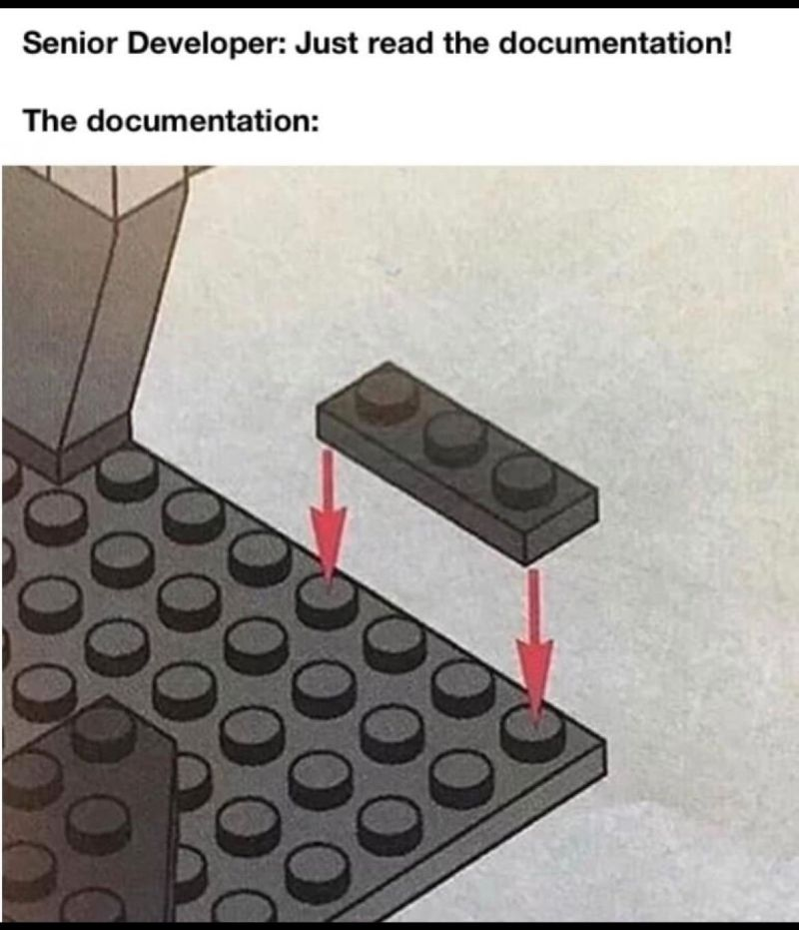

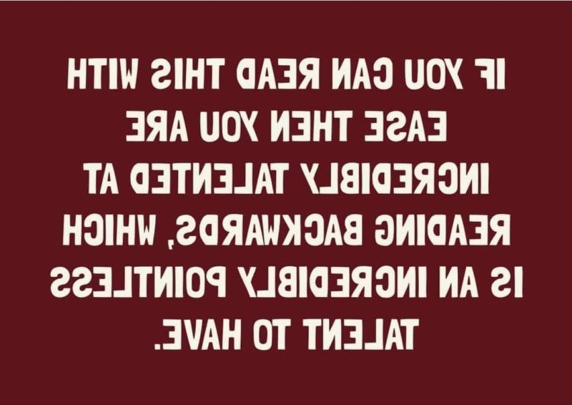


Slide 2
CSE 280 Discrete Mathematics
Week 03 Day 2
W. Clements
Mon: Functions 4.1 – 4.4
Wed: Logs & Exponents 4.5 – 4.6
Friday: Functional Programming (map, filter, reduce)

Slide 3
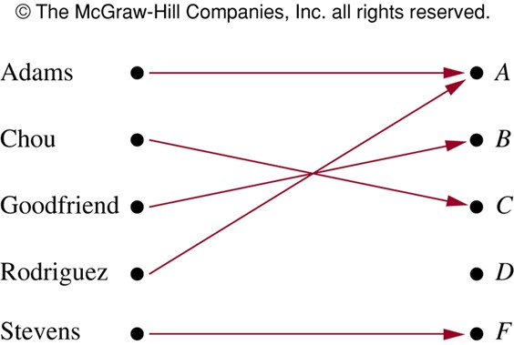
Functions
domain – ?
codomain – ?
range or image – Those members of the codomain that are actually used.
Example:
Function assigning grades in a discrete math class.
What is the domain?
{Adams, Chou, Goodfriend, Rodriguez, Stevens}
What is the codomain?
{A, B, C, D, F}
What is the range?
{A, B, C, F}
the set of all possible inputs
the set of all possible outputs
Note: A function $f:A→B$ is a subset of $A×B$
Rosen, Kenneth. Discrete Mathematics and Its Applications, 7th Edition. McGraw-Hill, 2012

Slide 4
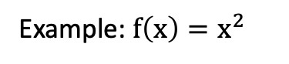
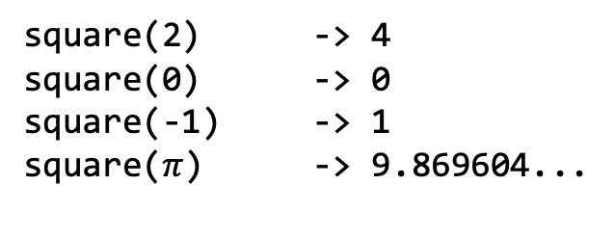
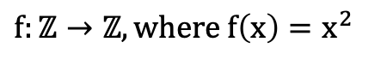
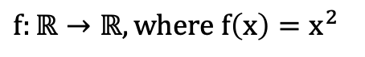
Functions
Example: $f\left(x\right)=x^{2}$
This function definition is not complete until we define the domain and target
What is the domain and target?
def square(n: float) -> float:
return n * n
$f:ℝ→ℝ, where f\left(x\right)=x^{2}$
$f:ℤ→ℤ, where f\left(x\right)=x^{2}$
def square(n: int) -> int:
return n * n
In Python:
def square(n):
return n * n
What is the domain?
All Real numbers (ℝ)?
int, float, ?
square(2) -> 4
square(0) -> 0
square(-1) -> 1
square($π$) -> 9.869604...
What is the codomain?
All positive Real numbers along with 0 ($ℝ^{+}∪\{0\}$)
int, float, ?
Example

Slide 5



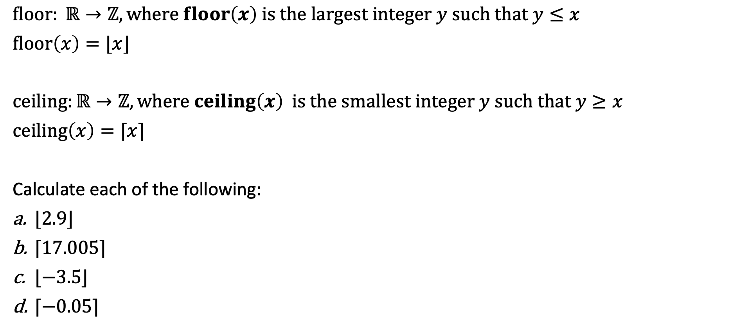

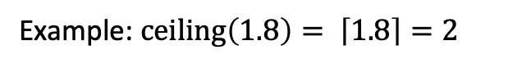

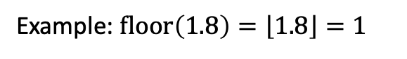

Floor and Ceiling
$$ℝ$$
$$ℤ$$
$$ℝ ?$$
1.0
1.1
1.2
…
1.9
2.0
1
2
1.0
2.0
$floor: ℝ→ℤ, where floor\left(x\right) is the largest integer y such that y≤x$
$floor\left(x\right)=⌊x⌋$
$ceiling:ℝ→ℤ, where ceiling\left(x\right) is the smallest integer y such that y≥x$
$ceiling\left(x\right)=⌈x⌉$
Calculate each of the following:
$⌊2.9⌋$
$⌈17.005⌉$
$⌊−3.5⌋$
$⌈−0.05⌉$
Example: $floor\left(1.8\right)=\left\lfloor 1.8\right\rfloor =1$
$$ℝ$$
$$ℤ$$
$$ℝ ?$$
1.0
1.1
1.2
…
1.9
2.0
1
2
Example: $ceiling\left(1.8\right)= \left\lceil 1.8\right\rceil =2$
In Python:
from math import floor, ceil
floor(-3.5) # -4
ceil(-0.5) # 0
2
18
-4
0
Example

Slide 6

What is a function?
Simplest form: An object that takes objects and gives other objects
Arity: Taking objects (parameters, arguments)
Unary
Binary
Also know as preimage, or plan, or dream
Order Matters
Prefix, Postfix, Infix
Infix: Normal Math
2 plus 2
Prefix:
Add 2 to 2
Postfix:
2 & 2 added together
Mapping
Onto, one-to-one
Map, reduce, filter
Output
Codomain vs Range
Range $∈$ Codomain
Those members of the codomain that are actually used
Addition range
Multiplication range
Floor Ceiling
Power range
Also known as image

Slide 7


Problem Statement
Expected Output
Instruction Givens
Processing needed
Input
Process
Output
main
getInteger
getFloat
getString
getFromFile
Processing
Update
Output-only
Filter
Map
Reduce
Data Structures
Print()
Display()
Gui

Slide 8
What is a function?
Simplest form: An object that takes objects and gives other objects
Arity: Taking objects (parameters, arguments)
Unary
Binary
Also know as preimage, or plan, or dream
Order Matters
Prefix, Postfix, Infix
Infix: Normal Math
2 plus 2
Prefix:
Add 2 to 2
Postfix:
2 & 2 added together
Mapping
Onto, one-to-one
Map, reduce, filter
Output
Codomain vs Range
Range $∈$ Codomain
Those members of the codomain that are actually used
Addition range
Multiplication range
Floor Ceiling
Power range
Also known as image

Slide 9




Function Classification
$$F(x)=x^{2},x∈ℝ$$
What is the codomain? Does it matter?
Select all that apply.
onto
one-to-one
injection
bijection
surjection
not a function
one-to-one
onto
both one-to-one
and onto
A = B if and only if A ⊆ B and B ⊆ A
$$A⊃B$$
A $⊂B$
$$A⊇B$$

Slide 10
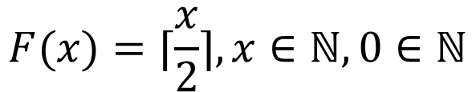
Function Classification
$$F(x)=⌈\frac{x}{2}⌉,x∈ℕ,0∈ℕ$$
Select all that apply.
onto
one-to-one
injection
bijection
surjection
not a function
one-to-one
onto
both one-to-one
and onto

Slide 11
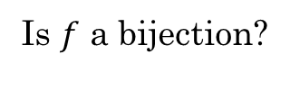
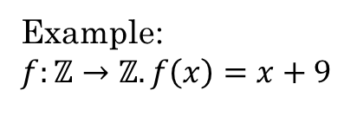
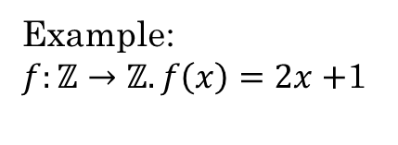
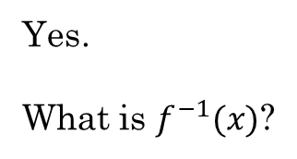
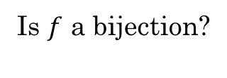
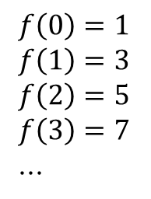
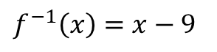
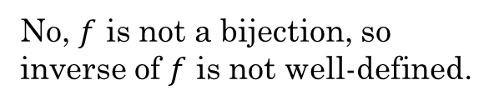
Inverse of a Function
A function $f$ has an inverse if and only if $f$ is a bijection.
The inverse can be obtained by swapping the items in each pair in $f$. $f^{−1}=\{\left(y,x\right):\left(x,y\right)∈f\}$
Example:
$f:ℤ→ℤ. f\left(x\right)=x+9$
Example:
$f:ℤ→ℤ. f\left(x\right)=2x+$1
Is $f$ a bijection?
Is $f$ a bijection?
Yes.
What is $f^{−1}(x)$?
$f\left(0\right)=1$
$f\left(1\right)=3$
$f\left(2\right)=5$
$f\left(3\right)=7$
...
No, $f$ is not a bijection, so inverse of $f$ is not well-defined.
$f^{−1}\left(x\right)=x−9$

Slide 12
Problem Sets
Do Additional Exercises
4.3.2
4.4.1
4.4.2 a-d

Slide 13
4.3.2
For each of the functions below, indicate whether the function is onto, one-to-one, neither or both. If the function is not onto or not one-to-one, give an example showing why.
(a) f: R → R. f(x) = x²
(b) g: R → R. g(x) = x³
(c) h: Z → Z. h(x) = x³
(d) f: Z → Z,
(e) f: Z → Z, f(x) = 5x - 4
(f) f: Z → Z, f(x) = x - 4
(g) f: Z × Z → Z × Z, f(x, y) = (x+1, 2y)
(h) f: Z × Z → Z × Z,
(i) f: Z × Z → Z × Z,
(j) f: Z × Z → Z × Z, f(x, y) = (1-y, 1-x)
(k) f: Z⁺ × Z⁺ → Z⁺, f(x, y) = 2^{x} + y.

Slide 14
4.3.2
For each of the functions below, indicate whether the function is onto, one-to-one, neither or both. If the function is not onto or not one-to-one, give an example showing why.
(a) f: R → R. f(x) = x² Not onto. Let y be a real number such that y < 0. Then there is no x such that x² = y. For example, there is no x ∈ R such that x² = -1. Not one-to-one. f(1) = f(-1) = 1.
(b) g: R → R. g(x) = x³ One-to-one and onto.
(c) h: Z → Z. h(x) = x³ Not onto. For example, there is no integer x, such that x³ = 2. One-to-one.
(d) f: Z → Z, Not one-to-one. For example, f maps both x = 1 and x = 2 to f(x) = -3. Onto.
(e) f: Z → Z, f(x) = 5x - 4 Not onto. For example, no integer x exists such that f(x) = 5x - 4 = 2. One-to-one.
(f) f: Z → Z, f(x) = x - 4 One-to-one and onto.
(g) f: Z × Z → Z × Z, f(x, y) = (x+1, 2y) One-to-one, but not onto. There is no pair (x, y) such that f(x, y) = (1, 1).
(h) f: Z × Z → Z × Z, Onto, but not one-to-one. f(1, 2) = f(2, 2).
(i) f: Z × Z → Z × Z, Neither one-to-one, nor onto. f(1, 2) = f(2, 2). There is no (x, y) such that f(x, y) = (0, 0).
(j) f: Z × Z → Z × Z, f(x, y) = (1-y, 1-x) One-to-one and onto.
(k) f: Z⁺ × Z⁺ → Z⁺, f(x, y) = 2^{x} + y. Neither one-to-one, nor onto. There is no (x, y) such that f(x, y) = 1. f(2, 2) = f(1, 4).

Slide 15

4.4.2 a-d
A function $f$ has an inverse if and only if $f$ is a bijection.
For each of the following functions, indicate whether the function has a well-defined inverse. If the inverse is well-defined, give the input/output relationship of $f^{−1}$.
f: Z-> Z. f(x) = x+3
f: Z->Z. f(x) = 2x+34
f: R->R. f(x) = 2x+3
A = {1-8} f:P(x) -> {1-8}
For X subset of A, f(X) = |X|
A finite set
P(X) – power set

Slide 16
4.4.2 a-d
For each of the following functions, indicate whether the function has a well-defined inverse. If the inverse is well-defined, give the input/output relationship of $f^{−1}$.
f: Z-> Z. f(x) = x+3
f: Z->Z. f(x) = 2x+34
f: R->R. f(x) = 2x+3
A = {1-8} f:P(x) -> {1-8}
For X subset of A, f(X) = |X|
A finite set
P(X) – power set
$f^{−1}$ = x -3
$f^{−1}$ The function is not one-to-one, so is not well-defined.
$f^{−1}$ = (x-3)/3
The function is not one-to-one, so is not well-defined.

Slide 17
Example 4.4.1: Encrypting messages.
The process of encrypting messages can be expressed through the mathematical language of functions.
Consider encrypting 16-digit credit card numbers. Let N be the set of all possible 16-digit numbers.
An encryption scheme for N is a function e: N → N.
In order to send a credit card number n ∈ N over an insecure communication channel, the sender would encrypt n by computing e(n).
The encryption function e is chosen to be a bijection.
The sender then sends e(n) over the channel. The receiver receives e(n) and wishes to decrypt the message to obtain the original number n.
To accomplish this, the receiver applies the inverse function e⁻¹ to e(n) in order to get the credit card number n: e⁻¹(e (n)) = n.
The sender and receiver need to communicate ahead of time so that the receiver knows what function e⁻¹ to apply to the number that is received.
A secure encryption scheme would have the property that without foreknowledge of the function e⁻¹, it would be difficult to determine n from e(n).

Slide 18
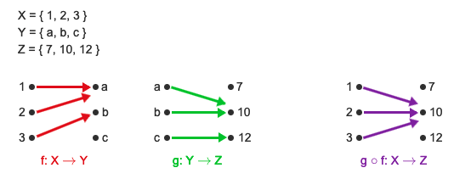
FoG: F of G: Function Composition
f and g are two functions, where f: X → Y and g: Y → Z. The composition of g with f, denoted g ο f, is the function (g ο f): X → Z, such that for all x ∈ X, (g ο f)(x) = g(f(x)).
Chain of Command
Chain of Responsibility
Command Line Piping : ls | grep “a”

Slide 19
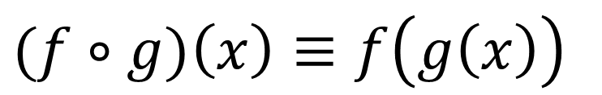
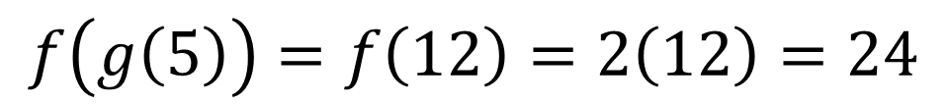
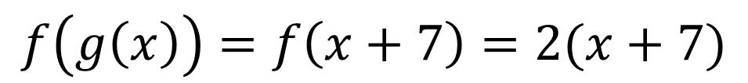
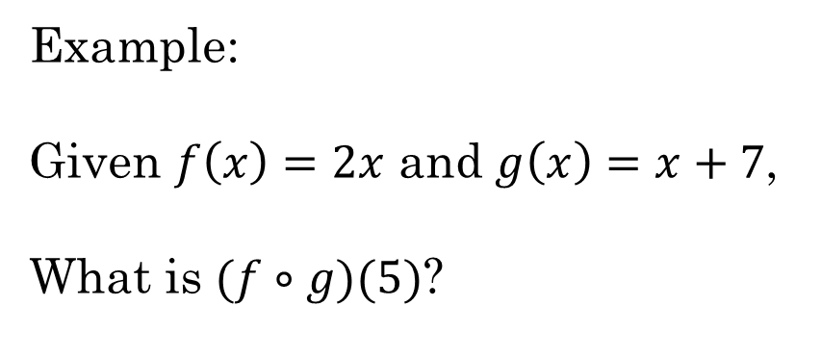
Function Composition
$(f∘g)\left(x\right)≡f\left(g\left(x\right)\right)$
Example:
Given $f\left(x\right)=2x$ and $g\left(x\right)=x+7$,
What is $(f∘g)(5)$?
$$f\left(g\left(x\right)\right)=f\left(x+7\right)=2(x+7)$$
$$f\left(g\left(5\right)\right)=f\left(12\right)=2\left(12\right)=24$$

Slide 20
Practice
Additional Exercises:
4.5.2 a-e
4.5.8 a,c

Slide 21
4.5.2 a-e
Consider three functions f, g, and h, whose domain and target are Z.
Let f(x) = x*x g(x) = 2^x h(x) = ceil (x/5)
(a) Evaluate (f ο g)(0)
(b) Evaluate (f ο h)(52)
(c) Evaluate (g ο h ο f)(4)
(d) Give a mathematical expression for h ο f.
(e) Give a mathematical expression for f ο g.

Slide 22
4.5.2 a-e
Consider three functions f, g, and h, whose domain and target are Z.
Let f(x) = x*x g(x) = 2^x h(x) = ceil (x/5)
(a) Evaluate (f ο g)(0) 1
(b) Evaluate (f ο h)(52) 121
(c) Evaluate (g ο h ο f)(4) 16
(d) Give a mathematical expression for h ο f. h o f = ceil (x^2/5)
(e) Give a mathematical expression for f ο g. f o g = 2^(2x)

Slide 23
4.5.8 a,c
The domain and target set of functions f, g, and h are Z. The functions are defined as:
f(x) = 2x + 3 g(x) = 5x + 7 h(x) = x² + 1
Give an explicit formula for each function given below.
(a) f ο g
(b) g ο f
(c) f ο h
(d) h ο f

Slide 24
4.5.8 a,c
The domain and target set of functions f, g, and h are Z. The functions are defined as:
f(x) = 2x + 3 g(x) = 5x + 7 h(x) = x² + 1
Give an explicit formula for each function given below.
(a) f ο g f ο g(x) = 10x + 17
(b) g ο f g ο f(x) = 10x + 22
(c) f ο h f ο h(x) = 2x² + 5
(d) h ο f h ο f(x) = 4x² + 12x + 10

Slide 25
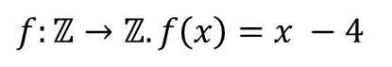
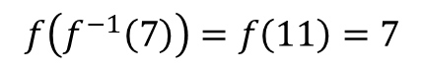
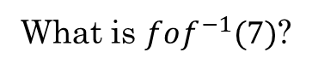
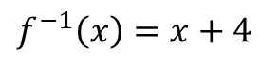
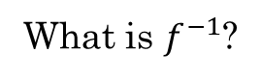
Function Composition
What is the result of composing a function $f$ with its inverse $f^{−1}$ ?
$f:ℤ→ℤ. f\left(x\right)=x −4$
What is $f^{−1}$?
$f^{−1}\left(x\right)=x+4$
What is $fοf^{−1}(7)$?
$$f\left(f^{−1}\left(7\right)\right)=f\left(11\right)=7$$
Any function composed with its inverse is the identity function, meaning the output is the same as the input.

Slide 27
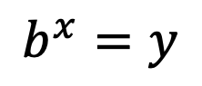
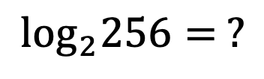
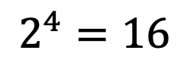
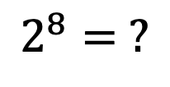
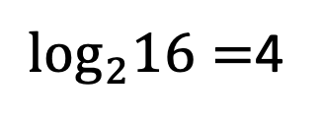
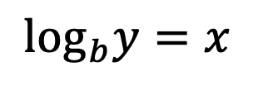
Exponents and Logarithms
$$b^{x}=y$$
The exponential function
$$\log_{b}y=x$$
The logarithm function
$$2^{4}=16$$
$\log_{2}16=$4
$$2^{8}= ?$$
$$\log_{2}256= ?$$

Slide 28
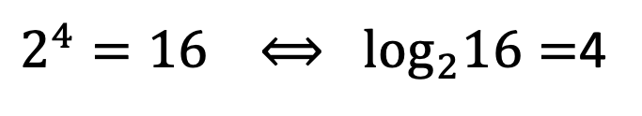
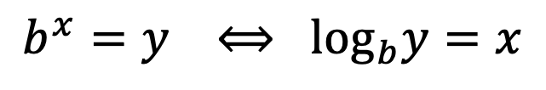
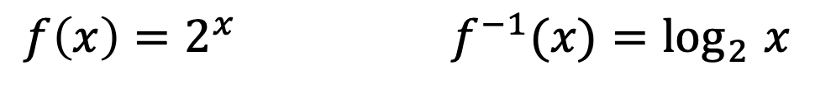
Exponents and Logarithms
$$b^{x}=y ⟺ \log_{b}y=x$$
The logarithm function is the inverse of the exponential function
$2^{4}=16 ⟺ \log_{2}16=$4
$${f\left(x\right)=2}^{x} f^{−1}(x){=log}_{2}x$$
$${f\left(4\right)=2}^{4}=16 f^{−1}\left(16\right){=log}_{2}16=4$$

Slide 29
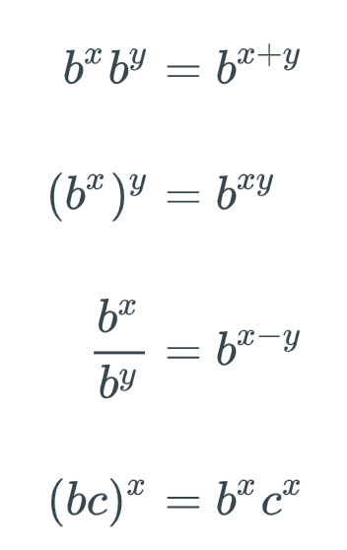
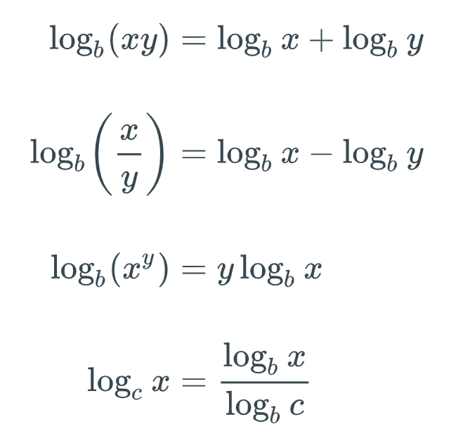
Exponents and Logarithms

Slide 30
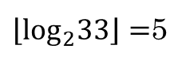
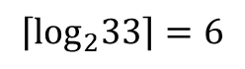
Exponents and Logarithms
You want to share a bag of Skittles with your friends. The bag has 33 Skittles. How many times can you divide your bag of skittles in half if you keep the larger pile each time?
$$\left\lceil \log_{2}33\right\rceil =6$$
If you keep the smaller pile each time?
$\left\lfloor \log_{2}33\right\rfloor =$5

Slide 31
https://learn.zybooks.com/zybook/BYUICSE280Fall2023/chapter/4/section/6
Do Additional Exercises
4.6.1
4.6.2

Slide 32
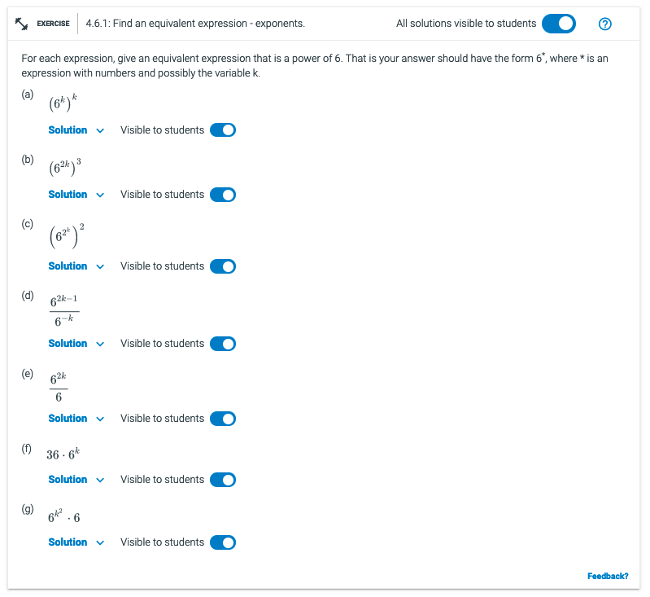
4.6.1

Slide 33
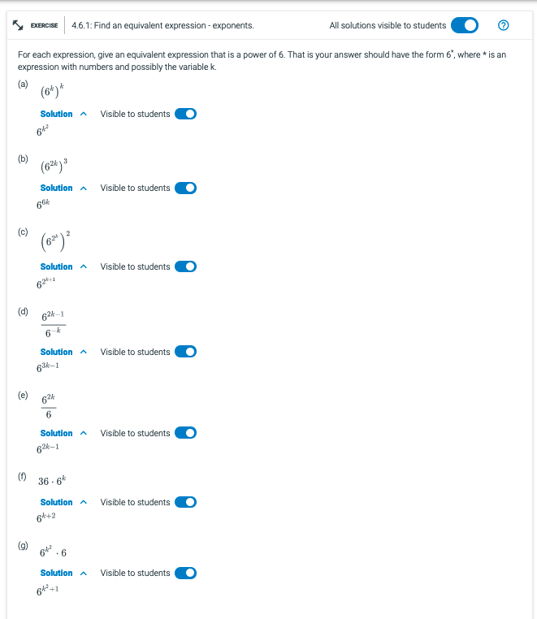

Slide 34
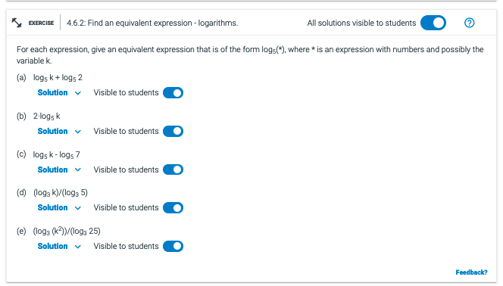
4.6.2

Slide 35
